Slide 1
Leveraging SDN Layering to Systematically Troubleshoot Networks
Brandon Heller★
Colin Scott
Nick McKeown⌘ Scott Shenker  Andreas Wundsam § Hongyi Zeng⌘ Sam Whitlock
Vimalkumar Jeyakumar⌘ Nikhil Handigol★ James McCauley Kyriakos Zariﬁs∞ Peyman Kazemian★
HotSDN 2013
Hong Kong
⌘Stanford
Berkeley
∞USC
ICSI
★SDN Academy
§Big Switch Networks
Notes:
The ideas in this position paper came out of a meeting a year ago with the west coasters shown on the slide. What we arrived at was a way to think about debugging in SDNs, which points out how we might build automatic tools, but also provides a framework to categorize the existing tools in this space.
------------------
We met up to find out just how our systems all fit together. The first output of that meeting was abstract: - a framework for thinking about systematic debugging with SDN - but the second was more concrete - a way for specific tools to enable automatic troubleshooting.
[Be inclusive - not about the affiliations - of which there are X]
Wikipedia Commons image:
http://en.wikipedia.org/wiki/File:USA_Antelope-Canyon.jpg

Slide 2
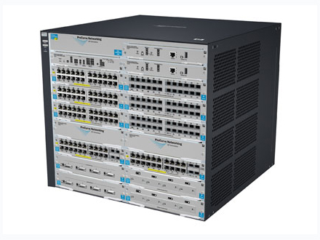
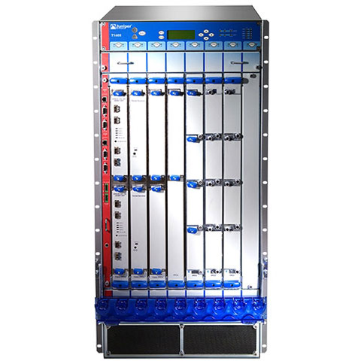
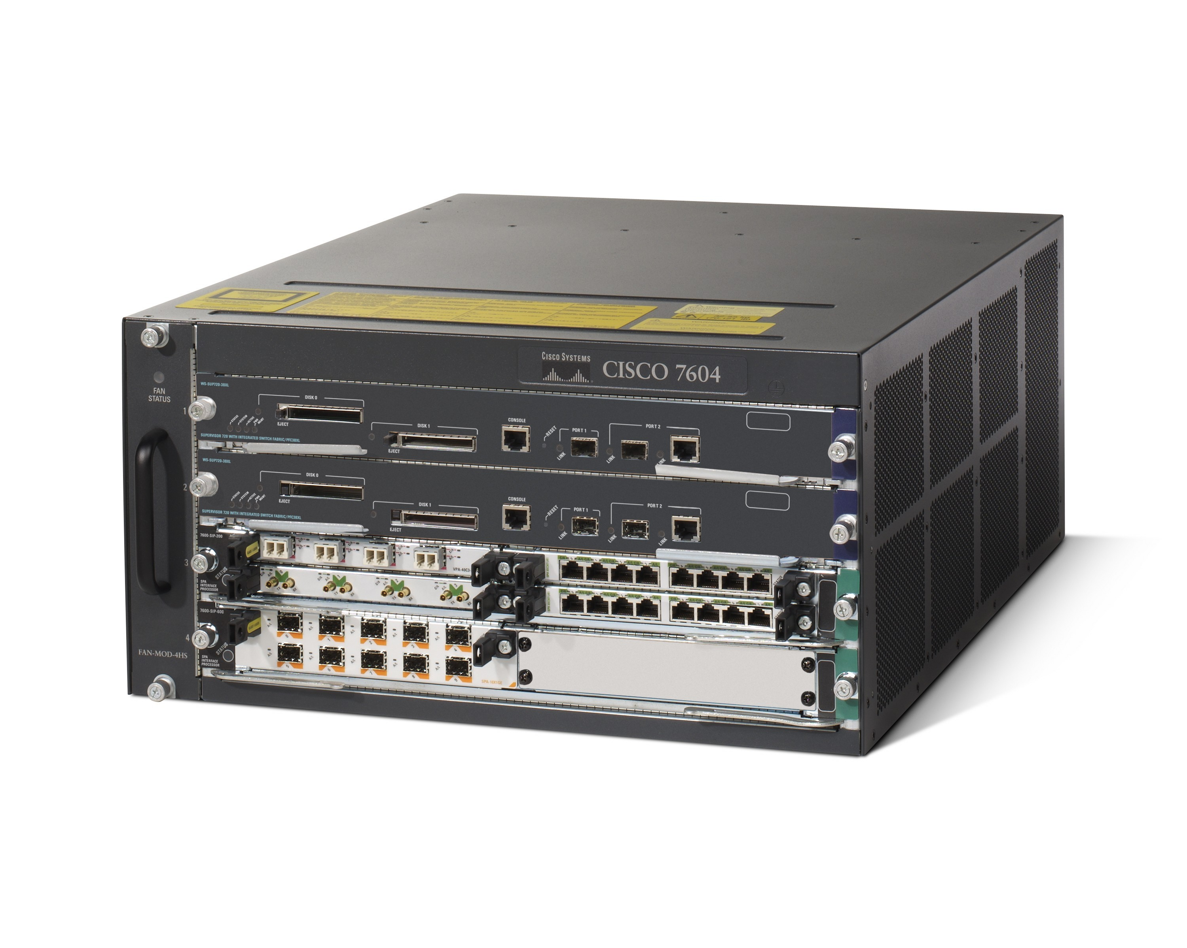
This Talk
2: Troubleshoot
Policy
Network
Admin
connect hosts A + B
quarantine virus-infected hosts
route guest traffic to an HTTP proxy
prioritize SSH
+
Protocols
Configuration
Topology
→
skills + tools + knowledge
3: Fix Stuff!
1: Configure
Ethane, overlays, consistency primitives, network programming languages, …
Notes:
Let’s start with a quick reminder of the jobs of a network admin who runs a traditional network with standard distributed protocols.
[CLICK] The first job is to configure each network element such that the combination of protocols, configuration, and topology implements the desired policy. Policy includes things like connectivity vs isolation, middlebox routing, and traffic priorities.
[CLICK[ The second job is to troubleshoot: to operate tools, like ping, traceroute, tcpdump, and SNMP, whenever the network no longer seems to implement the desired policy, to figure out what’s going wrong.
[CLICK] The third job, if there’s still any time left in the day, is to actually fix stuff.
[C] Naturally, you might want to give the admins more time in the day, by automating configuration tasks with smart software. Tons of projects at SIGCOMM and especially HotSDN have focused on this – in fact, things like Ethane, Overlays, and network programming languages are all ways to automatically map a policy onto a network substrate, frequently by building on SDN. This is great stuff, but we’re not going to talk about it.
[C] What we will talk about is how you might enable troubleshooting that is systematic, or possibly even automatic, using software means.
Plus, in a recent survey, network admins were asked what they wanted, and the clear #1 desire [CLICK] was a way to automatically troubleshoot the network.

Slide 3
This Talk
2: Troubleshoot
Policy
Network
Admin
#1 request from network admins:
Automatic Troubleshooting
Source: “Automatic Test Packet Generation”, CoNEXT ‘12, Zeng et al.
connect hosts A + B
quarantine virus-infected hosts
route guest traffic to an HTTP proxy
prioritize SSH
+
Protocols
Configuration
Topology
→
skills + tools + knowledge
3: Fix Stuff!
1: Configure
Ethane, overlays, consistency primitives, network programming languages, …
Notes:
Let’s start with a quick reminder of the jobs of a network admin who runs a traditional network with standard distributed protocols.
[CLICK] The first job is to configure each network element such that the combination of protocols, configuration, and topology implements the desired policy. Policy includes things like connectivity vs isolation, middlebox routing, and traffic priorities.
[CLICK[ The second job is to troubleshoot: to operate tools, like ping, traceroute, tcpdump, and SNMP, whenever the network no longer seems to implement the desired policy, to figure out what’s going wrong.
[CLICK] The third job, if there’s still any time left in the day, is to actually fix stuff.
[C] Naturally, you might want to give the admins more time in the day, by automating configuration tasks with smart software. Tons of projects at SIGCOMM and especially HotSDN have focused on this – in fact, things like Ethane, Overlays, and network programming languages are all ways to automatically map a policy onto a network substrate, frequently by building on SDN. This is great stuff, but we’re not going to talk about it.
[C] What we will talk about is how you might enable troubleshooting that is systematic, or possibly even automatic, using software means.
Plus, in a recent survey, network admins were asked what they wanted, and the clear #1 desire [CLICK] was a way to automatically troubleshoot the network.

Slide 4
How to automate troubleshooting?
Challenging in traditional networks.
?
Policy
Network
~
Two requirements.
Know the intended policy:
confusing: different config format for each protocol
distributed: configuration spread among all nodes
hard: must understand all protocols & their interactions
isolate groups A + B
route guest traffic to an HTTP proxy
block a list of virus-infected hosts
impractical to infer
(2) Check behavior against policy:
confusing: don’t know lowest-level forwarding behavior
distributed: hard to get a meaningful snapshot
difficult to check
Notes:
Let’s consider how you might automate troubleshooting, by dropping a box into the network.
[CLICK] I assert that you’d need to ensure two requirements are met.
[CLICK] First, you need to know the intent of the admin.
The challenge is that policy is implicit in the node configuration, on the specific topology.
Config is protocol-specific, spread around, unclear how to compose
You’d have to reverse-engineer it, with a lot of engineering.
If you looked at the config files, you find that they can be confusing, with proprietary ones for each protocol. These files are spread among all nodes. Even if you knew all the CLI outputs and pulled them all into a central place, it still might not be clear what their intent was, because you’d have to understand all the protocols and their interactions with the topology, and there can multiple ways to implement the same simple policies, like connectivity or isolation. So I’m going to mark intent as impractical to infer, because the intent is implicit in the configuration of all protocol configurations over all nodes.
[CLICK] Let’s say you could build software to understand their intent – you’d next have to check the behavior of the network against their intent.
One starting point would be to look at a snapshot of the lowest-level forwarding state to ensure that there’s nothing obviously wrong the network, like an unspecified black hole or a forwarding loop. Then you could throw all possible packets into a simulated network and see if it’s doing the right thing.
On a single switch, it might be reasonably easy to get a CLI dump of the state and then piece together what should happen. But you really want a network-wide snapshot, and with traditional distributed protocols, you’ll never know if the possible snapshot is a useful one – because we may be looking at temporary, unconverged state.
You could use precision time synchronization to take a snapshot, or modify every protocol to support this, but that seems unlikely.
In short, it’s difficult to check behavior against intent, because it’s hard to get a clear view.
# Practically hard to guarantee a snapshot for the state of a single protocol that is consistent across the network, if that state is changing.
# Plus a single protocol isn’t enough; you really want a consistent snapshot of every protocol.
# You could modify every protocol or centrally collect logs, but it would be practically tough. Unlikely to be able to do these traditional network.

Slide 5
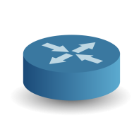
Control-Plane Layering in SDN
State Layers
Code Layers
Policy
App
App
App
Logical View
Network Hypervisor
Physical View
Network OS
Device State
Firmware
Firmware
Firmware
Hardware
HW
HW
HW
Notes:
Now instead of a traditional network running distributed protocols, let’s say we have an SDN. I’m going to use a diagram with two kinds of layers.
The first kind, on the left, are the state layers; with each of these, you can take a snapshot, and know what would happen to any packet. Each of these defines network behavior.
The second kind, on the right, are what we’ll call code layers; these are all programs that map a higher-level configuration to a lower-level configuration.
At the top, the input is an administrator’s policy, which Apps compile into a logical view; an example here would be OpenStack Neutron. The role of the network hypervisor, next, is to translate the logical view into the physical view. Then the Network OS takes the physical view and implements it in each hardware-abstracted network device, which might be defined by something like OpenFlow. Finally, firmware maps from the abstract view into physical registers in forwarding chips.
Now Colin’s going to show you why this layering is useful.
[Switch to Colin]

Slide 6
Systematically Troubleshooting an SDN
State Layers
Code Layers
Observation:
Each state layer fully specifies network behavior.
Policy
App
App
App
Logical View
Insight:
Bugs manifest as mistranslations between layers.
Network Hypervisor
Physical View
Network OS
Systematic Approach:
Binary search to isolate to a code layer.
Leverage state to isolate within the code layer.
Device State
Firmware
Firmware
Firmware
Hardware
HW
HW
HW
Notes:
Each state layer completely defines the behavior of the network. It answer a question of: should a packet from A be able to get to B? For example, we can answer this question if we have all virtual network view, the physical view, the device state, or the hardware config. All of these are sufficient; they completely define the behavior. [STATE]
[Slow Down] Here’s our main insight: bugs manifest as mistranslations between layers.
[Explain each error]
Why is this pretty cool? Because it provides a way to systematically track down the bug, down to a single layer, if we have tools that can check mapping between state.
Approach: binary search to find layer, then track down within the layer.
In general, we want to emphasize the "control plane" part of layering, since people know all about dataplane layering -- the insight here is that SDN is the first time layering has been applied to the control plane.
-----------------
Give hat tip to Martin’s blog post?

Slide 7
Phase 1: Localizing to a code layer
Symptom: Hosts unable to communicate
[Operator Intent]
Policy
Anteater
[SIGCOMM ‘11]
Apps
Logical View
?
NetHyperV
~
No
Yes
Yes
Physical View
?
~
No
SOFT
[CONEXT ‘12]
NetOS
Device State
?
Firmware
~
No
Cause: Firmware Bug
Hardware
Yes
[Actual Behavior]
Notes:
Mention the checks, then show that we arrive at a hardware error, with a repeatable test case for the particular switch.
Localizing here means: down to a switch, and then to a rule.

Slide 8
Phase 1: Localizing to a code layer
Symptom: Tenant Isolation Breach
[Operator Intent]
Policy
HSA
[NSDI ’12]
Correspondence Checking
Apps
Logical View
?
?
Yes
NetHyperV
~
~
No
No
Yes
Yes
Physical View
?
~
OFRewind
[ATC ‘11]
No
?
Yes
NetOS
~
No
Device State
Firmware
Cause: NetHypervisor Bug
Hardware
[Actual Behavior]

Slide 9
How to automate troubleshooting?
Possible in Software-Defined Networks
?
Policy
Network
~
Two requirements.
Know the intended policy:
confusing: different config format for each protocol
distributed: configuration spread among all nodes
hard: must understand all protocols & their interactions
isolate groups A + B
route guest traffic to an HTTP proxy
block a list of virus-infected hosts
directly provided
app
fewer nodes
(2) Check behavior against policy:
confusing: don’t know lowest-level forwarding behavior
distributed: hard to get a meaningful snapshot
directly accessible

Slide 10
Takeways
Control plane layering enables systematic troubleshooting
Thinking about troubleshooting in terms of layers shows us where tools fit in
Reveals missing tools
Highlights choices between tools, with tradeoffs
Plenty of opportunities left.
Operationalize!
Notes:
Our personal take is that we’re not done here, and there are plenty of opportunities left to operationalize this workflow, and to improve all the pieces that make it possible.

Slide 11
Leverage the layers in SDN.
Brandon Heller★
Colin Scott
Nick McKeown⌘ Scott Shenker  Andreas Wundsam § Hongyi Zeng⌘ Sam Whitlock
Vimalkumar Jeyakumar⌘ Nikhil Handigol★ James McCauley Kyriakos Zariﬁs∞ Peyman Kazemian★
HotSDN 2013
Hong Kong
⌘Stanford
Berkeley
∞USC
ICSI
★SDN Academy
§Big Switch Networks
Questions?
Notes:
In short, leverage the layers in SDN to systematically troubleshoot.
Any questions?

Slide 12
How is this different than general distributed systems debugging?
Simple answer: it’s not! SDN is an excellent opportunity to draw upon ideas from other distributed systems
Subtlety: networks are solving a much more constrained problem than general distributed systems

Slide 13
Limitations
Correctness only, not performance
Side effects not reflected in state
No guarantee of finding single code layer
No guarantee of individual layer correctness
No guarantee of future correctness
Layer visibility may be imperfect

Slide 14
Plenty of Opportunities Remain
Automatic Troubleshooting → Actionable Bug Reports
Filtering the signal from the noise
Creating consistent views of state
Improving Invariant Checkers
Scale
Flexible Policy Input
Hybrid Traditional + SDN Debugging
Notes:
A different direction is improving invariant checkers. The ones we have today are a good start, but they still have scaling issues and may not be able to take the policy input directly, to check it.
Lastly, we’ve described clean-slate SDN so far, but a mix with traditional networking is more practical in the short-term, so it would be nice if we could apply these ideas to hybrid networks.

Slide 15
Plenty of Opportunities Remain
Automatic Troubleshooting → Actionable Bug Reports
Filtering the signal from the noise
Creating consistent views of state
Forwarding State
Forwarding State
Packet History:
Path + Headers + Forwarding State
Forwarding State
Forwarding State
[HotSDN 2012:
Where is the Debugger for My Software-Defined Network?]
Notes:
A second example is to create consistent views of state. One example is the Packet History, which shows the exact forwarding state used to process a packet along a path, along with any modification. These can also be automatically generated by a tool called NDB.

Slide 16
Plenty of Opportunities Remain
Automatic Troubleshooting → Actionable Bug Reports
Filtering the signal from the noise
Controller A
Switch 1
Switch 2
Switch3
Minimal Causal Sequence
Controller B
Switch 4
Switch 5
Switch 6
Controller C
Switch 7
Switch 8
Switch 9
[Berkeley Tech Report:
How Did We Get Into This Mess? Isolating Fault-Inducing Inputs to SDN Control Software]
Notes:
We’re not done, and there are plenty of research opportunities outstanding. We’re going to end with a few of the most exciting ones.
First, the job of a troubleshooting tool should not just be to identify a repeatable, understandable test case, but to provide an actionable bug report.
[CLICK]
The problem is that a bug report that might include tons of messages and state, all changing over time, and it’s not clear what’s relevant. The admin still needs to extract the signal from the noise.
[CLICK] One example construct that can automatically process the signal is a Minimal Causal Sequence, which represents only the inputs that are necessary and sufficient to trigger a bug. These can be generated automatically by a tool called STS.

Slide 17
Isn’t this unnecessary with consistency primitives/languages/etc?
No
Catch/rule out bugs outside the framework
Catch instances where the framework pushes config that breaks the policy

Slide 18
What’s novel about this work?
Simple answer: nothing!
Notes:
“Nothing!” is too strong… should at least point out the value of the work.

Slide 19
Control-Plane Layering in SDN
State Layers
Code Layers
Example Errors
[Unintended Config]
Policy
App
App
App
Configuration Parsing Error
Logical View
Network Hypervisor
Tenant isolation breach
(policy mistranslation)
Physical View
Network OS
Failover logic error,
synchronization bug
Device State
Firmware
Firmware
Register misconfiguration,
Router memory corruption
Firmware
Hardware
HW
HW
HW
[External Connectivity Error]
Notes:
Now instead of a traditional network running distributed protocols, let’s say we have an SDN. I’m going to use a diagram with two kinds of layers.
The first kind, on the left, are the state layers; with each of these, you can take a snapshot, and know what would happen to any packet. Each of these defines network behavior.
The second kind, on the right, are what we’ll call code layers; these are all programs that map a higher-level configuration to a lower-level configuration.
At the top, the input is an administrator’s policy, which Apps compile into a logical view; an example here would be OpenStack Neutron. The role of the network hypervisor, next, is to translate the logical view into the physical view. Then the Network OS takes the physical view and implements it in each hardware-abstracted network device, which might be defined by something like OpenFlow. Finally, firmware maps from the abstract view into physical registers in forwarding chips.
Now Colin’s going to show you why this layering is useful.
[Switch to Colin]

